Slide 1

Week of 11/27 Deliverables
Red Lemurs

Slide 2
Deliverables
Complete all MEDA plots
Link for eeg data examples
Link for phenotypic data examples
Data Munging of Phenotypic data
Detect ordinal columns and replace nan values with column means
Detect badly formatted column names and replace
need to fix categorical repeats (disorder vs. Disorder vs. disorders)
Basic Frequency-Domain Plots of Multivariate Time Series
Prototype of webservice on HBN Phenotypic data
Wireframe and UI plans
Demo running on Phenotypic data

Slide 3
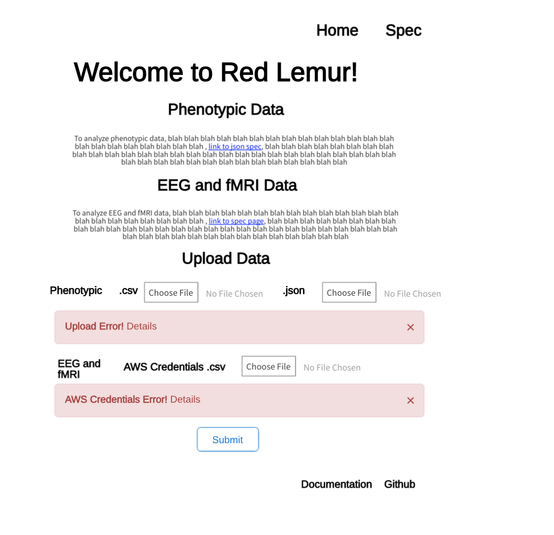
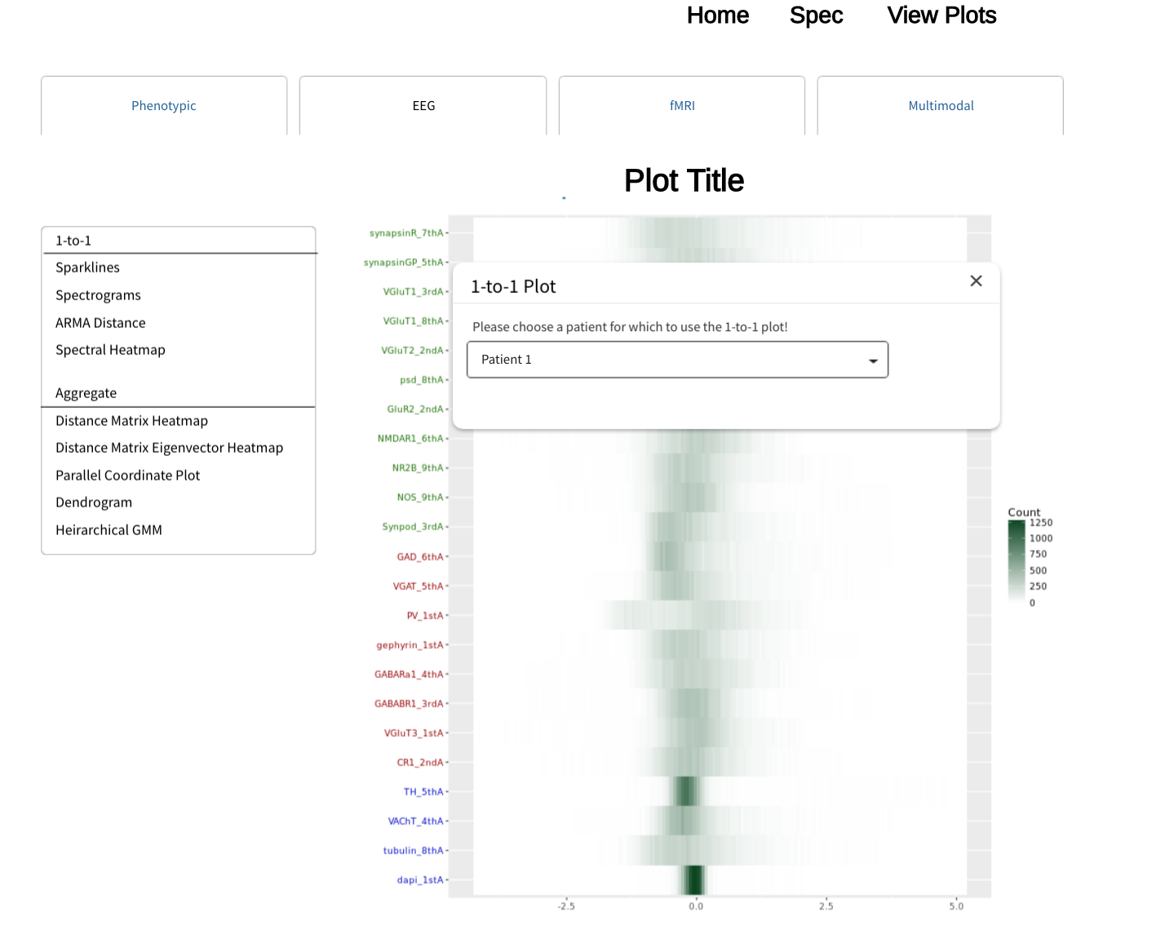
Wireframe Drawing

Slide 4
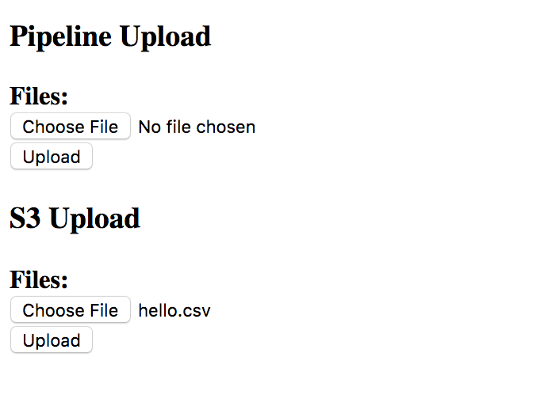
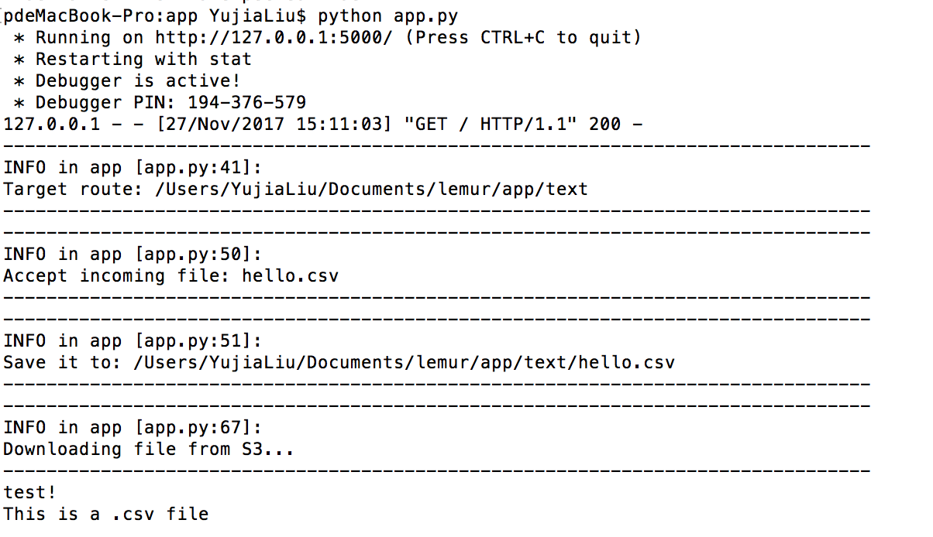
S3 bucket in webservice
Upload button send files (limited to .csv) to S3 bucket
Upload to/download from S3 bucket tested

Slide 5
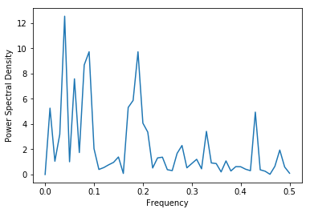
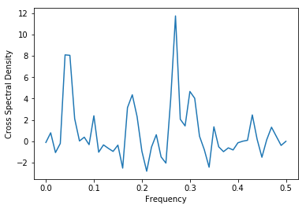
Basic Frequency Domain Plots (Ronak)
Univariate: Power Spectral Density (Periodogram)
Fourier Transform of Autocorrelation Function.
Plot for AR(1) process with phi = 0.5
Multivariate: Cross Spectral Density
Fourier Transform of Crosscorrelation Function.
Plot for two AR(1) processes with phi = 0.75 and 0.25 respectively.
Link to notebook.

Slide 6
Next Week
Add 2D fMRI surface plot from pycortex (scope before Weds, pivot if code is broken)
Add 2D graph projection plot (we like diffusion map, sklearn has an implementation, so done before Weds)
Working demo Weds. for all Phenotypic plots. Monday, add EEG plots.
Meeting with Dan Naiman about useful multivariate time series representations in both domains.

